Slide 1
Journey Radar
Travel with Peace of Mind.
From people for people.

Slide 2
Table of contents
01
02
03
04
05
06
07
About us
Problem
Solution
Core Features
Demo (Region Focus)
Impact
Next Step

Slide 3

01
About us

Slide 4
Problems
No commuter feedback loop
travelers have no way to flag disruptions into the transport grid.
Uncertainty & stress
lack of visibility creates anxiety during journeys.
Slow official updates
confirmed delay information often arrives late or incomplete.

Slide 5
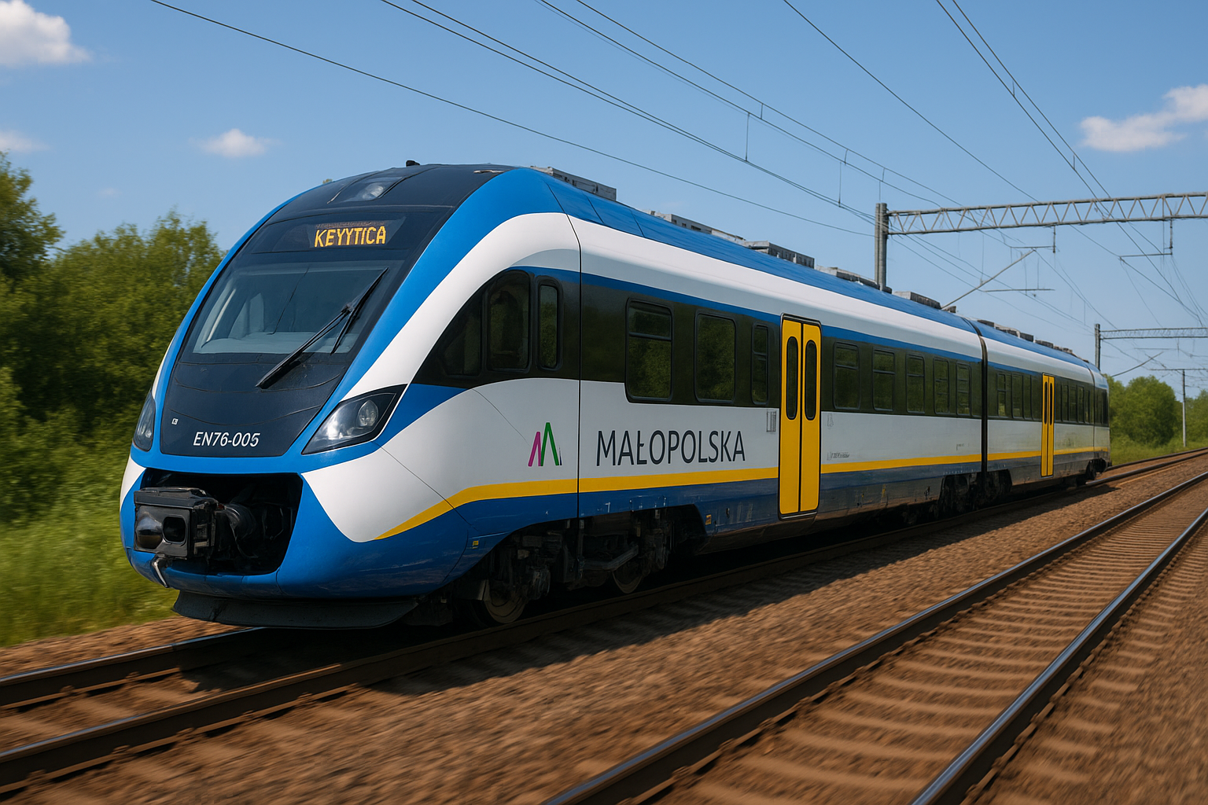
Solution
Interactive map – a clear, always-on view of your journey and disruptions ahead.
Trusted visibility – combines official transport updates with community reports.
Real-time reporting – commuters can instantly flag issues they see on their route.
Smart differentiation – separates potential vs confirmed incidents for reliable decision-making.

Slide 6
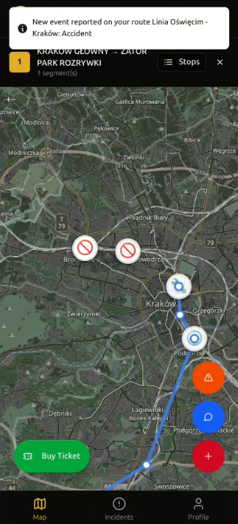
Core Features
4
Issue Reporting – one-tap “Report Issue” with categories (traffic, crash, weather, delay).
Route Planning – enter start & destination, see the fastest route with disruptions highlighted.
Live Commute Tracking – follow your
journey in real time with continuous updates.
Notifications – Implemented notifications system based on user reputation
3
2
1

Slide 7
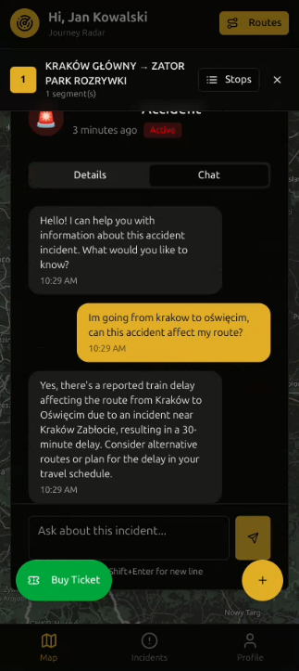
Core Features
5. Chatbot - RAG-based chatbot for interpreting transport and official data.
6. Level & Reputation System - Community-driven reputation system promoting fair app use.
7. Events – Matching official events submitted by users and national organizations/authorities along selected routes.
5

Slide 8
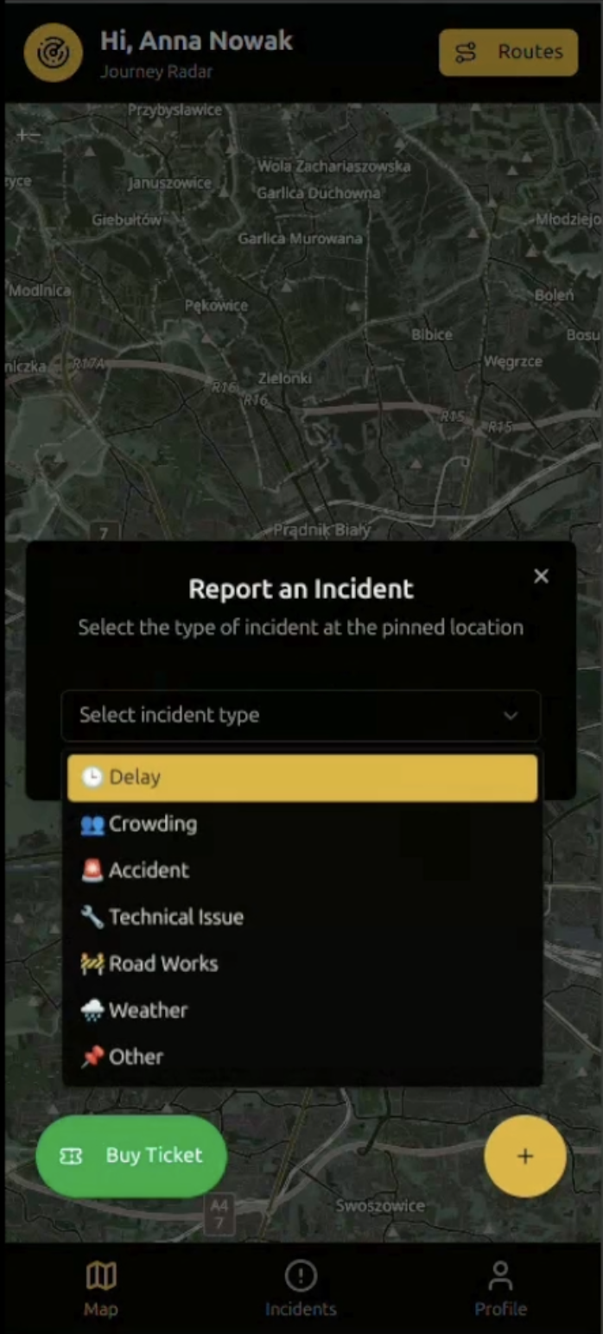
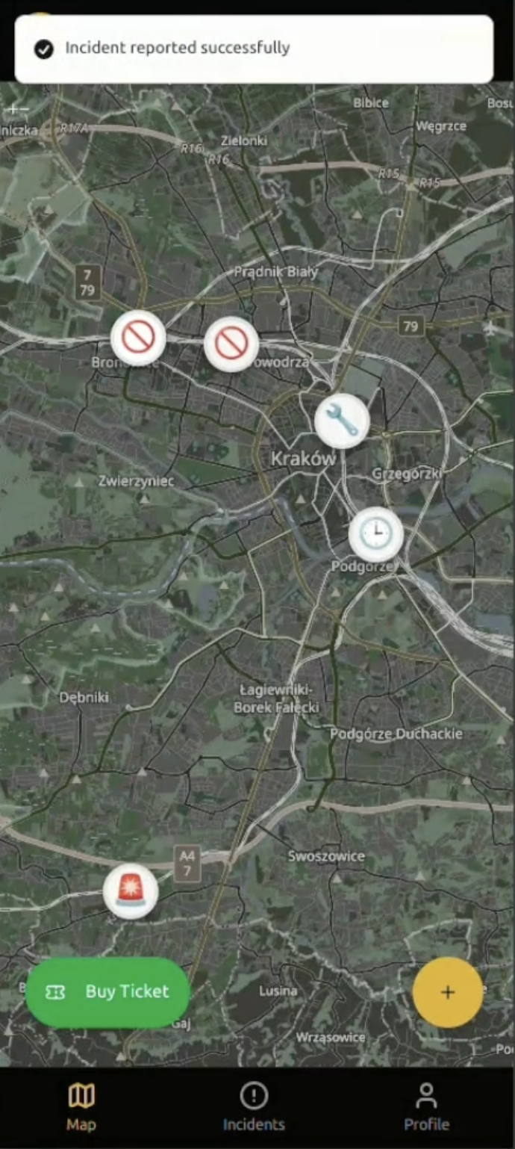
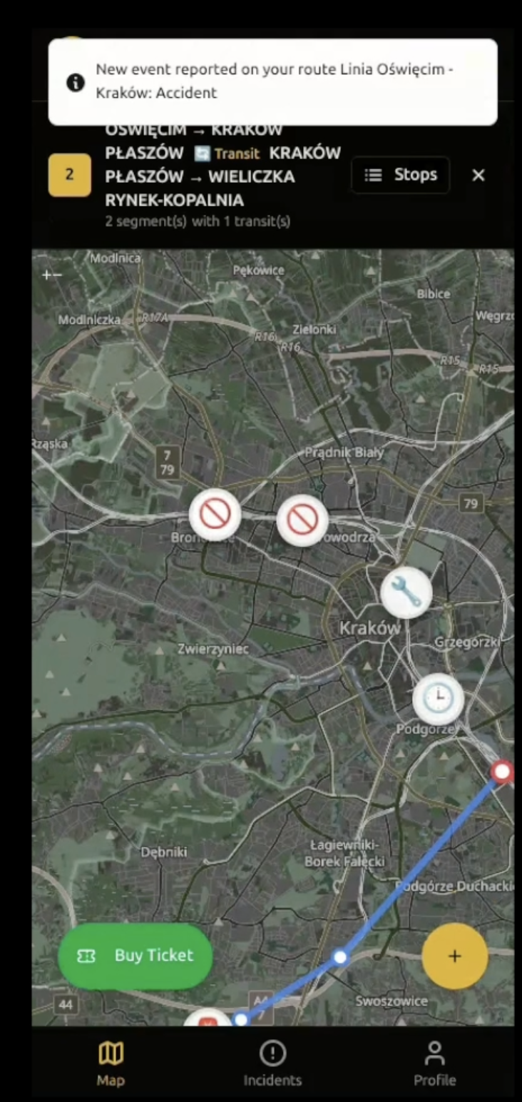
Demo of Notifications
User 1
User 2

Slide 9
Impact
Reduced stress
Time saved
Community-driven
commuters react to disruptions instantly, not after long delays.
commuters react to disruptions instantly, not after long delays.
real-time visibility lowers travel uncertainty and anxiety.
Trust & reliability
Scalable vision
clear separation of rumors (potential) vs verified (confirmed).
pilot in Małopolska → expansion across Poland → Europe.

Slide 10
Next Steps
Travel with Peace of Mind. From people for people.
Data
Develop accurate ML models to cluster user reports to further verify validity
Integrate multiple data sources: GTFS feeds, RCB alerts, portalpasazera.pl, and official operator APIs.
Community & Engagement
Gamify reporting: Rewards in the form of discounted rail travel for consistent correct reporting of issues
Encourage community-driven moderation (upvote/downvote reports).
Vision
Extend to all modes: buses, regional trains, intercity, trams.
Position as a layer between official operators & commuters — the missing info bridge.

